Slide 1

Presented by:
Ullas B C
Nikitha T
Vishrutha R
Rakshitha A
RSA ALGORITHM

Slide 2
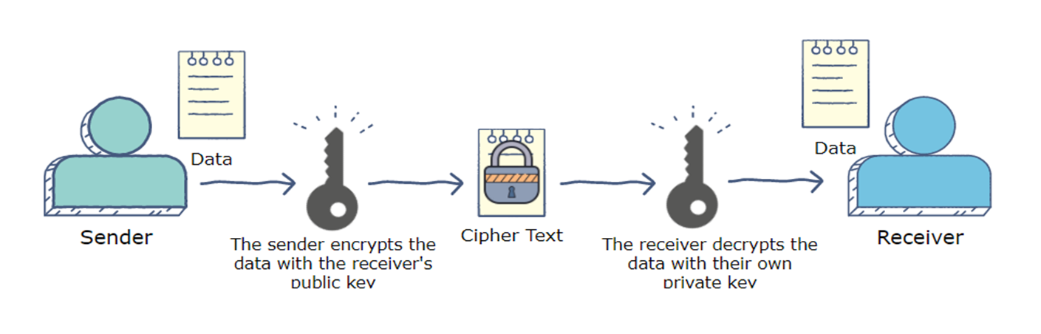
ASYMMETRIC CRYPTOGRAPHY ALGORITHM
In asymmetric cryptography algorithm, the sender encrypts the message using the receiver's public key, allowing only the receiver to decrypt the message using his or her own private key. The RSA algorithm is an asymmetric cryptography algorithm. It uses a public key and a private key.
Fig. Illustration of asymmetric cryptography

Slide 3
DESCRIPTION OF RSA ALGORITHM
The RSA algorithm is named after those who invented it in 1978: Ron Rivest, Adi Shamir, and Leonard Adleman.
Plain text and Cipher text are integers between 0 and n-1.
Encryption strength depends on the key size and if we double or triple the key size , the strength of the encryption increases exponentially.
RSA key size can typically be 1024 or 2048 bits long.
Plain text is encrypted in blocks , with each block having binary value less than n.

Slide 4
Generating public key
Select two prime no's. Suppose P and Q.
Now First part of the Public key : n = P*Q.
Select an integer e , such that e is coprime to Φ(n) and 1 < e < Φ(n)
Φ(n) is totient function, Φ(n) = (P-1)*(Q-1).
Our Public Key is made of (e,n).

Slide 5
Generating private key
Calculate d such that , ed modΦ(n) = 1 .
d ≅ e⁻¹ modΦ(n) .
d can be found using the extended euclidean algorithm.
The pair (n,d) makes up the private key.
ENCRYPTION : Given the plaintext M , C can be calculated as ,
C = Me modn
DECRYPTION : Using the private key (n,d) , the plaintext can be found using: M = C^{d} modn

Slide 6
Code for RSA
import math print("PLEASE ENTER THE 'p' AND 'q' VALUES BELOW:") p = int(input("Enter a prime number for p: ")) q = int(input("Enter a prime number for q: ")) print("_______________________________________________________\n") # Prime Function def prime_check(a): if a == 2: return True elif ((a < 2) or ((a % 2) == 0)): return False elif (a > 2): for i in range(2, a): if not (a % i): return False return True check_p = prime_check(p) check_q = prime_check(q) while (check_p == False) or (check_q == False): p = int(input("Enter a prime number for p: ")) q = int(input("Enter a prime number for q: ")) check_p = prime_check(p) check_q = prime_check(q)

Slide 7
# RSA Modulus '''CALCULATION OF RSA MODULUS 'n'.''' n = p * q print("RSA Modulus(n) is:", n) # Eulers Toitent '''CALCULATION OF EULERS TOITENT 'r'.''' phi = (p - 1) * (q - 1) print("Eulers Toitent(phi) is:", phi) print("_______________________________________________________\n") def gcd(a, b): # Everything divides 0 if (b == 0): return a return gcd(b, a % b) # Function to check and print if # two numbers are co-prime or not def coprime(a, b): if (gcd(a, b) == 1): return a else: return 0 '''Choose e such than less than phi''' for i in range(2, phi): if (coprime(i, phi)!=0): e = coprime(i, phi) break

Slide 8
def mult_inv(e,phi): for i in range(1,1000): d=((phi*i)+1)/e frac, whole = math.modf(d) if(frac==0): d=int(d) return d print("The value of e is:", e) print("_______________________________________________________\n") d = mult_inv(e, phi) print("The value of d is:", d) print("_______________________________________________________\n") public = (e, n) private = (d, n) print("public key :(e,n) ",public) print("private key :(d,n) ",private) print("_______________________________________________________\n") #Encryption def encrypt(pub_key, i): e, n = pub_key i=int(i) c = (i ** e) % n return c #Decryption def decrypt(priv_key, i): d, n = priv_key i=int(i) m = (i ** d) % n return m

Slide 9
message = input("Would you like to Encrypt or Decrypt?\n(Separate numbers with ',' for decryption):") print("Your message is:", message) # Choose Encrypt or Decrypt and Print choose = input("Type '1' for encryption and '2' for decrytion.") if (choose == '1'): enc_msg = encrypt(public, message) print("Your encrypted message is:", enc_msg) print("Thank you for using the RSA. Goodbye!") elif (choose == '2'): print("Your decrypted message is:", decrypt(private, message)) print("Thank you for using the RSA. Goodbye!") else: print("You entered the wrong option.") print("Thank you for using the RSA. Goodbye!")

Slide 10
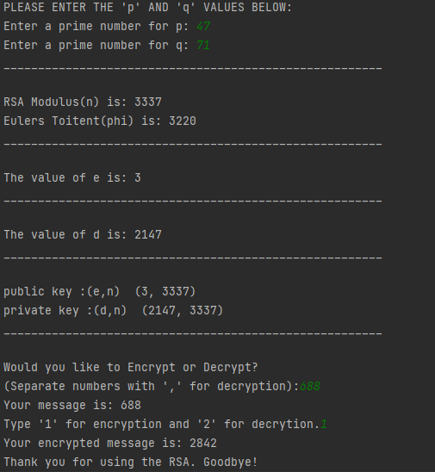
Output for Encryption

Slide 11
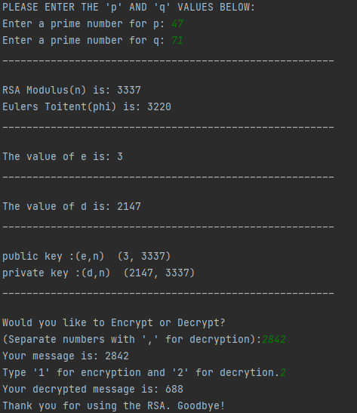
Output for Decryption

Slide 12
APPLICATIONS
RSA encryption is widely used for data encryption of e-mail and other digital transactions over the Internet.
RSA has been used extensively in various application from Bluetooth, MasterCard, VISA, e-banking, e-communication and e-commerce platforms.
When a server is encrypted using RSA one can use tools such as puTTY (public server) to access the server.

Slide 13
APPLICATIONS
Banking : RSA algorithm is commonly used by banks to protect their data, like customer information and transaction record. Some scenarios are credit card and office computers.
Telecommunications : RSA algorithm is useful to encrypt the call data as a concern for privacy issues.
E-commerce : RSA algorithm is useful in protecting user identity for transactions.

Slide 14
ADVANTAGES
RSA algorithm is safe and secure for its users through the use of complex mathematics.
RSA algorithm is hard to crack since it involves factorization of prime numbers which are difficult to factorize.
The encryption process is faster than DSA algorithm.

Slide 15
DISADVANTAGES
RSA algorithm can be very slow in cases where large data needs to be encrypted by the same computer.
It requires a third party to verify the reliability of public keys.
Data transferred through RSA algorithm could be passed through the middlemen who might tamper with the public key system.

